Slide 1
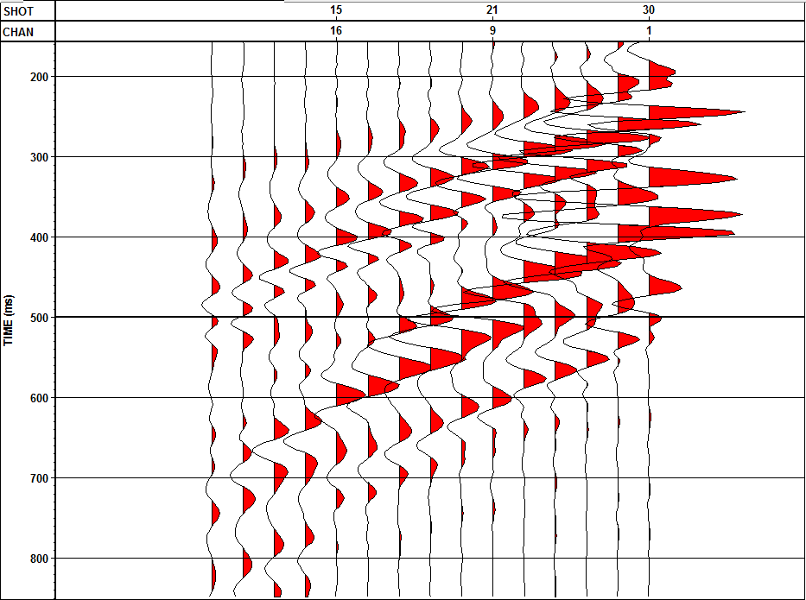
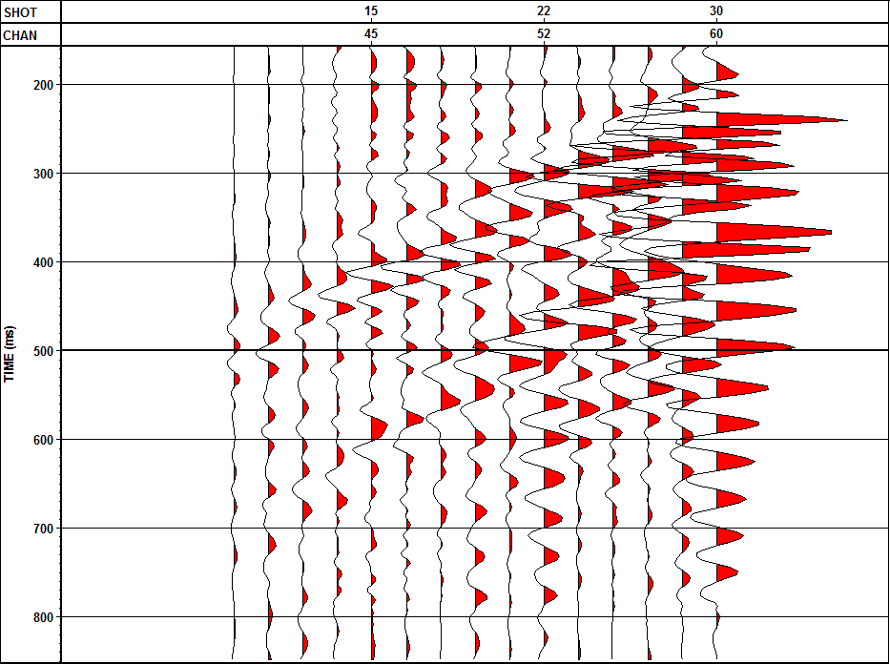
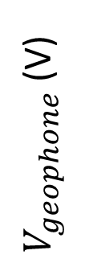
Traditional System
Seismic Spider System
$V_{geophone}$(V)
100 200 300 400 500 600 100 200 300 400 500 600
Time (ms)

